Slide 1
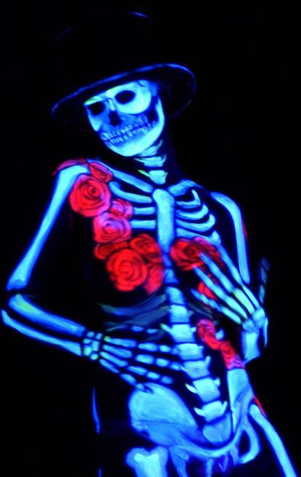
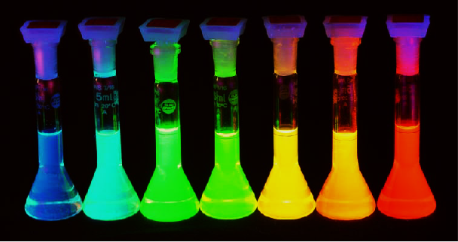
Fluorescence

Slide 2
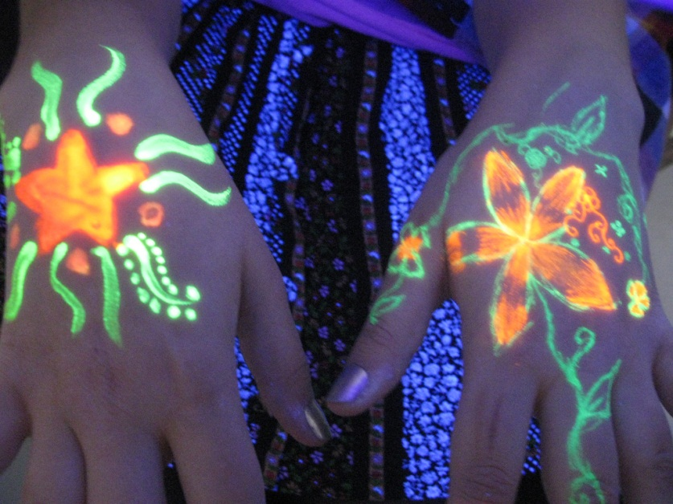
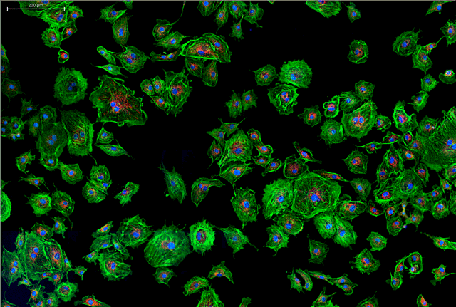

Fluorescence
Fluorescence is the emission of VISIBLE electromagnetic radiation by a substance that has absorbed radiation of a higher (not visible) frequency. E.g.. U.V. Radiation.
Fluorescent materials are actually PRODUCING visible light.

Slide 3
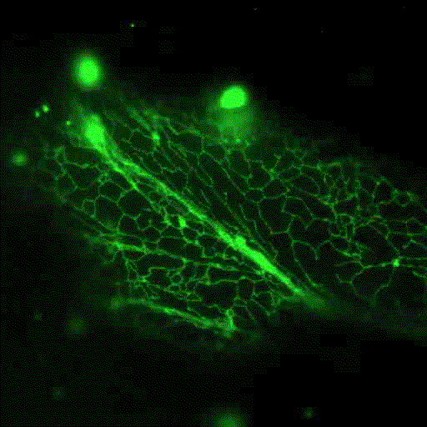
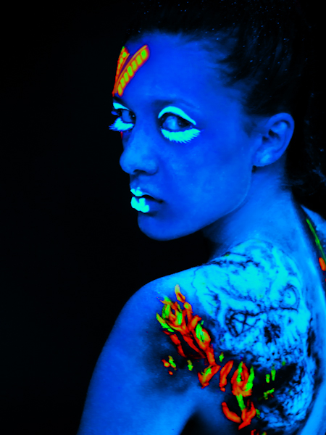

Fluorescence
In fluorescence, the emission and absorption follow each other quite rapidly, so that fluorescence lasts only as long as the illuminating radiation is on.
In phosphorescence, however, the emission occurs quite slowly and persists for a long time after the illuminating radiation has been turned off.

Slide 4
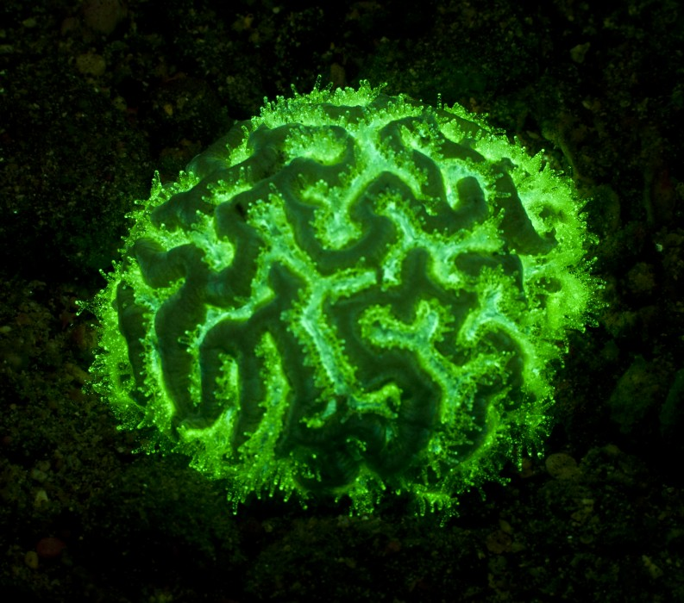



Fluorescence
+
Absorbs Photon of High Energy / frequency
electromagnetic radiation
e⁻
e⁻
e⁻
Emits Photons of lower Energy / frequency VISIBLE electromagnetic radiation
Wave length of released photon

Slide 5
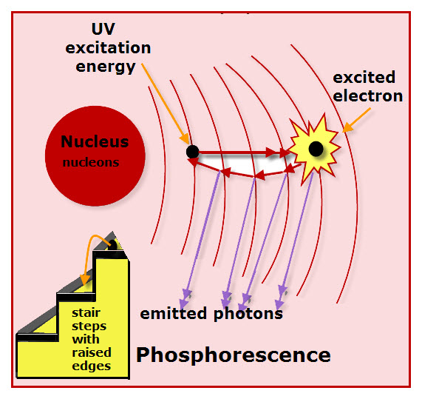
Fluorescence
Fluorescence, will only occur when the energy (and therefore the frequency) of the incoming photon exactly matches the difference between the energy levels through which the electron must be raised.
Excited electrons move from ground state to a high energy level (at least 2 steps above)
As the excited electrons move back down to ground state they “cascade” through a series of smaller jumps.
Since these jumps are also smaller in terms of energy, they release lower frequencies of radiation according to:
If these frequencies correspond to visible light, the substance fluoresces.

Slide 6
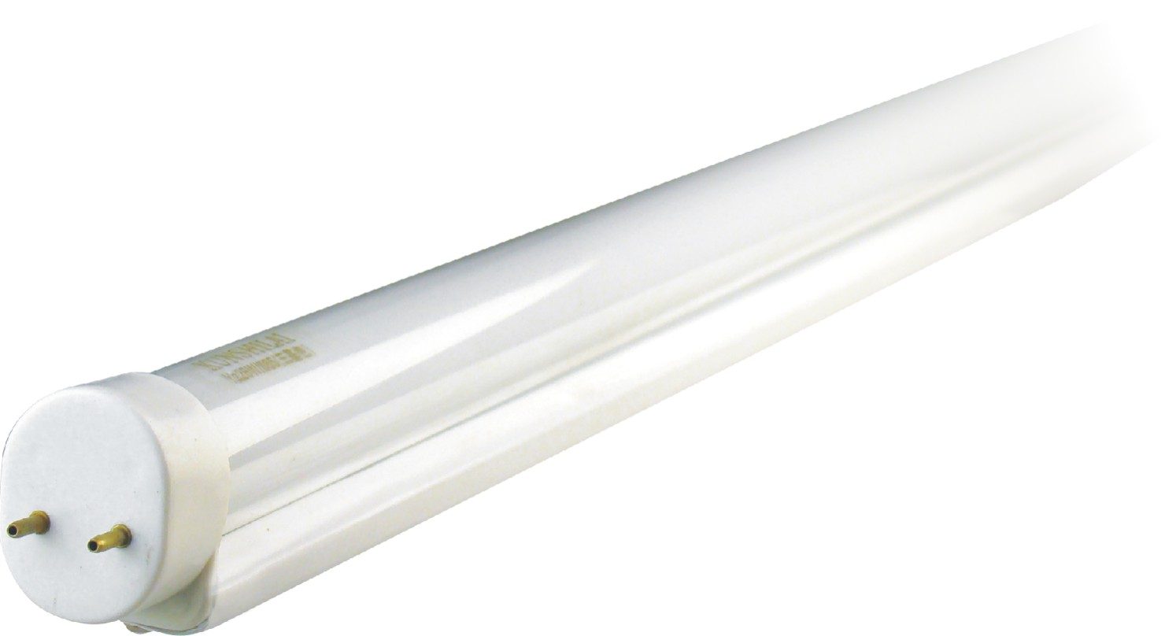
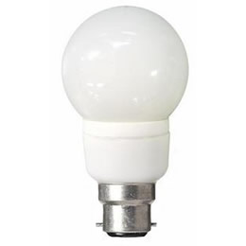
What about Fluorescent Lights?

Slide 7
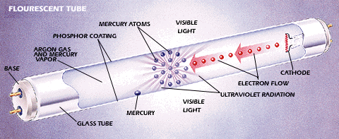
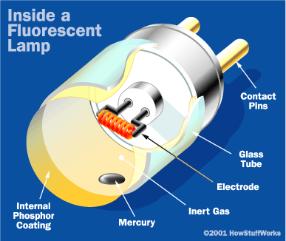
Fluorescent Lights
The central element in a fluorescent lamp is a sealed glass tube.
The tube contains a small bit of mercury and an inert gas, typically argon, kept under very low pressure.
The tube also contains a phosphor powder, coated along the inside of the glass.
The tube has two electrodes, one at each end, which are wired to an electrical circuit that produces a very high potential difference (voltage) between each end.

Slide 8
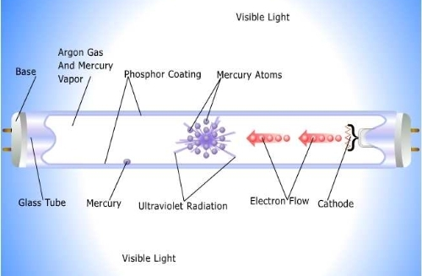
Fluorescent Lights
When you turn the lamp on, there is a considerable voltage across the electrodes, so electrons will migrate through the gas from one end of the tube to the other.
This energy changes some of the mercury in the tube from a liquid to a gas.
As electrons and charged atoms move through the tube, some of them will collide with the gaseous mercury atoms.
These collisions excite the atoms, bumping electrons up to higher energy levels.
When the electrons return to their original energy level, they release ULTRA VIOLET light photons.

Slide 9
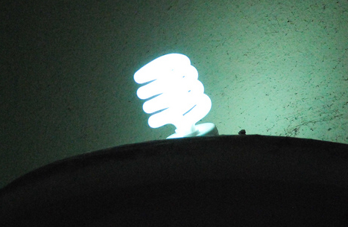
Fluorescencent Lights
Since the inside of the tube is coated in phosphor, the ULTRA VIOLET light photons are absorbed by the coating.
This energy now excites the PHOSPHOR atoms, bumping their electrons up to higher energy levels.
As PHOSPHOR electrons return to their original energy level, they do so by cascading through a series of smaller jumps.
These smaller jumps release lower frequencies of light corresponding to the visible spectrum.
I.e the Phosphor Fluoresces !

Slide 10


